Slide 4
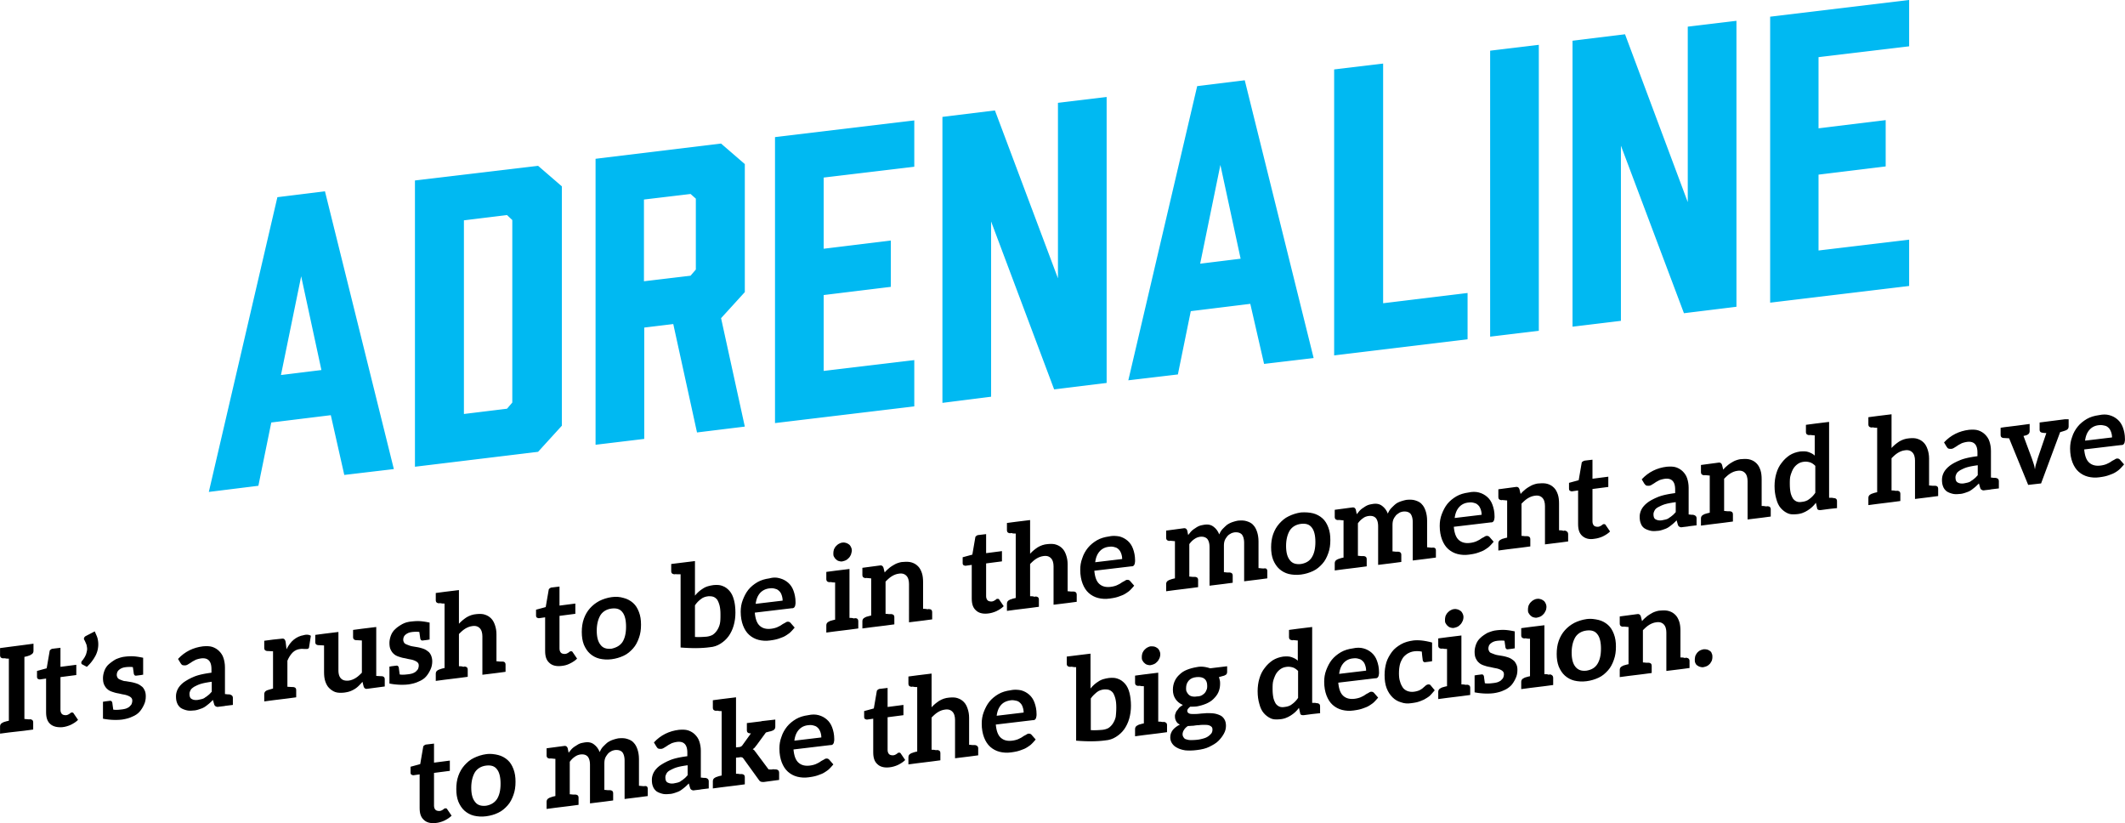

Slide 6
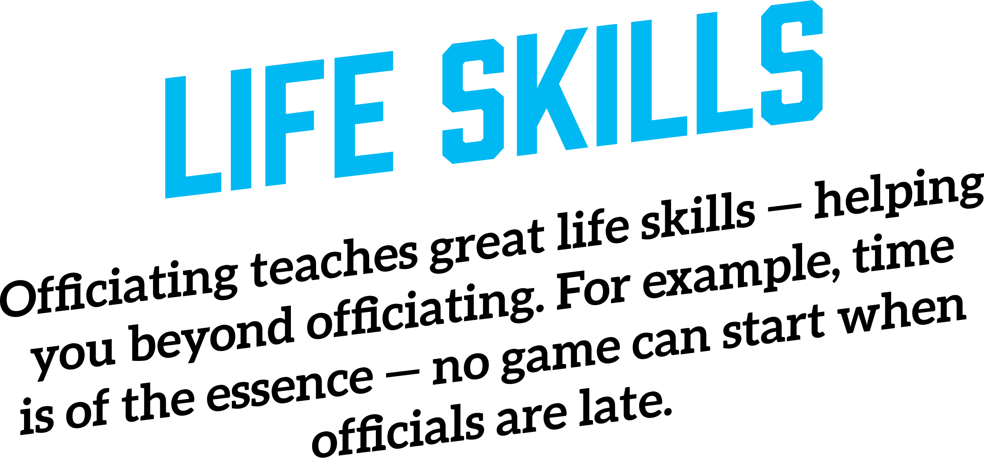

Slide 7
MEMORIES
The longer you work, the more memories you will build. Some will be great games; others the talented players. Most importantly, you’ll remember your great partners and mentors.

Slide 9
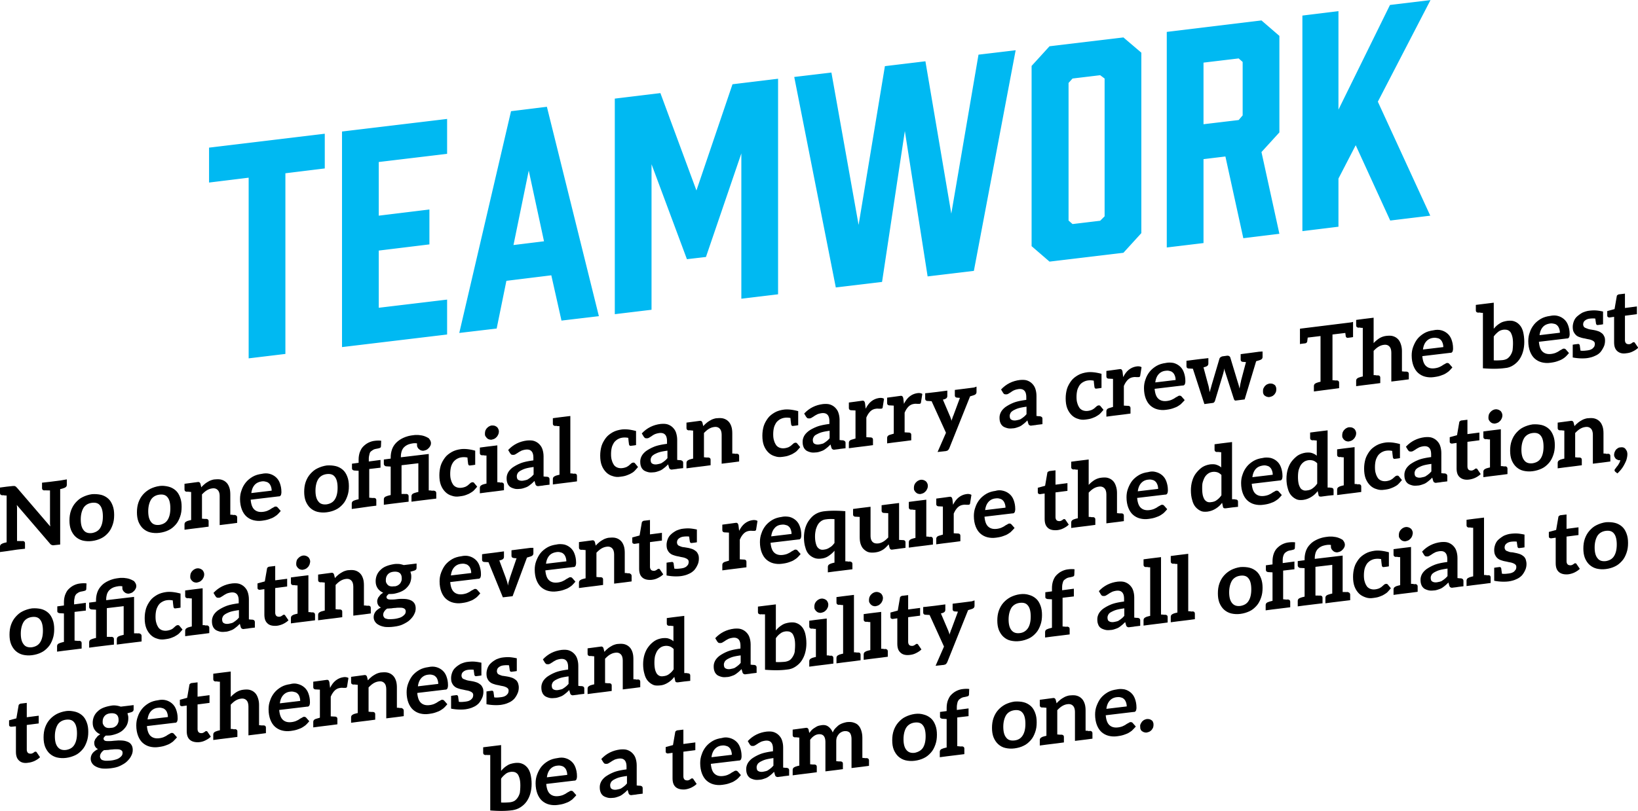

Slide 10
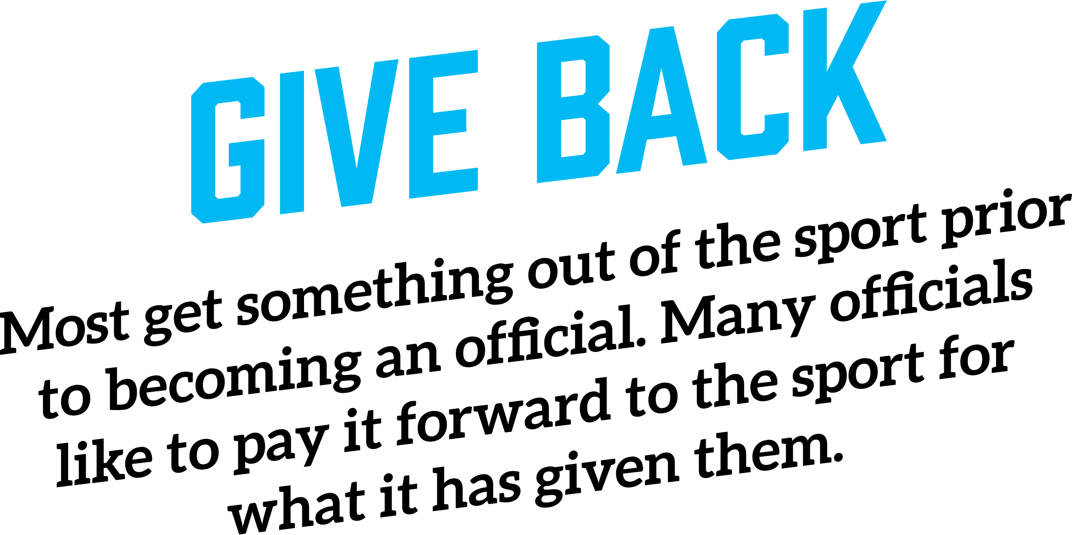

Slide 11
ESCAPE
Once an official steps onto the field, everyday problems disappear.

Slide 12
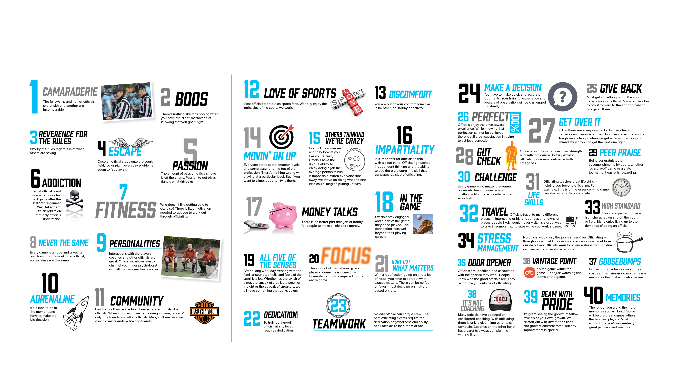

Slide 13
JOIN PVFOA TODAY
Say YES to Officiating and join the PVFOA today. We offer training on & off the field, mentorship, and game assignments when you are ready to take the field.
Contact our recruitment coordinator Carey Drayton at cmdtabm@gmail.com.
pvfoa.org

